Slide 1
Tableau

Slide 2
What is Tableau?
Tableau is a business intelligence (BI) and data visualization tool
Used to analyze data and create interactive dashboards, reports, and visualizations
Does not require extensive programming knowledge.
Tableau is developed by Tableau, which is part of Salesforce.

Slide 3
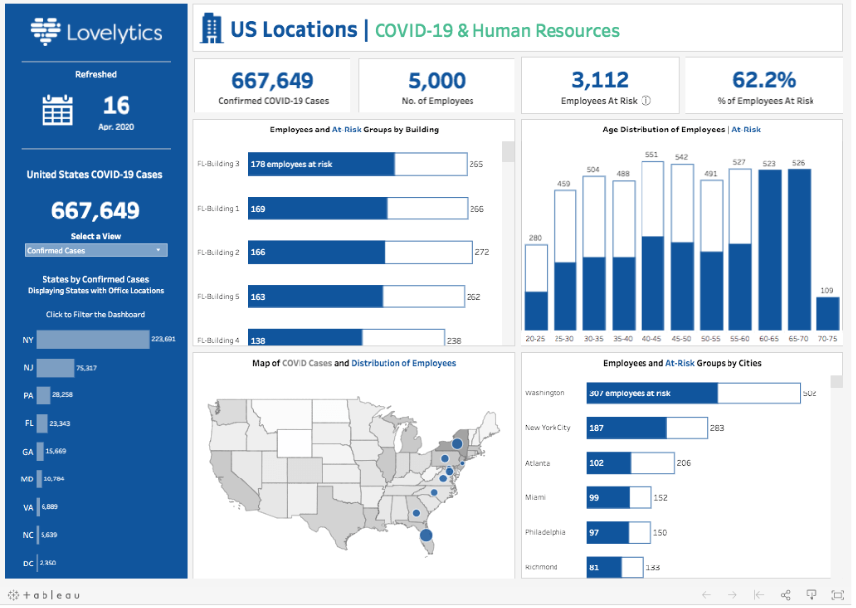
Covid – 19 Dashboard

Slide 4
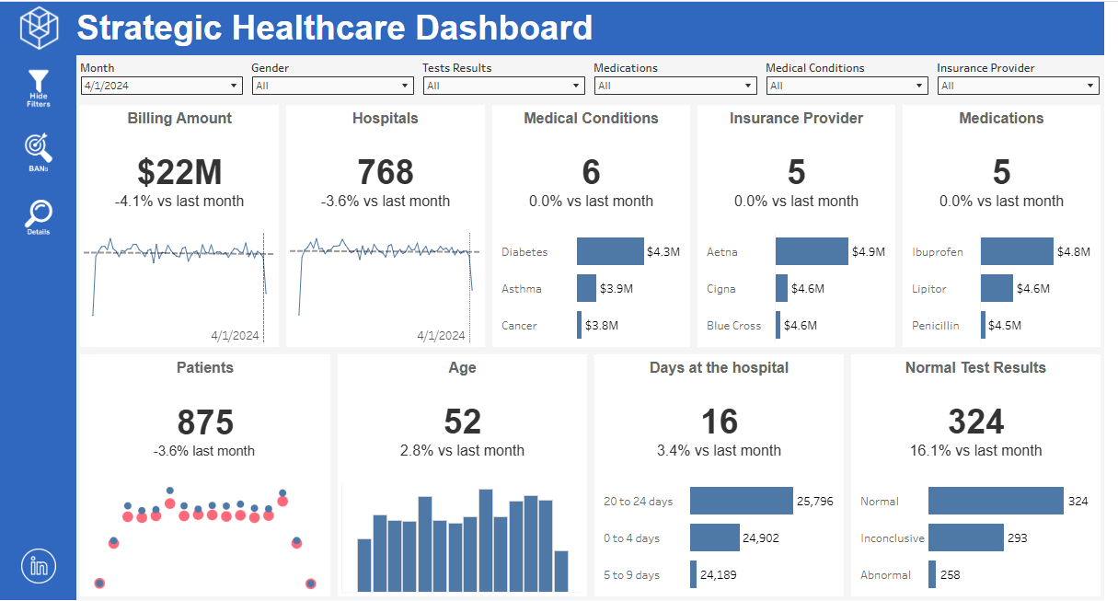
Hospital Dashboard

Slide 5
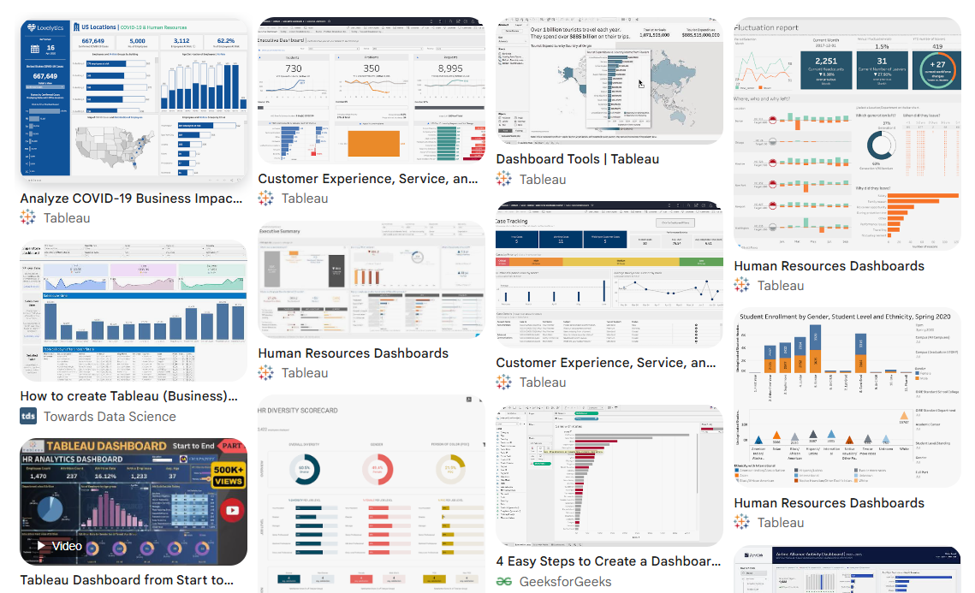

Slide 6
A dashboard is designed to answer three questions quickly:
What is happening?
Is it good or bad?
What action should I take?
Because of this, most dashboards contain the following components.
1. KPI Cards (Most Important Numbers)
Usually displayed at the top.
KPI | Meaning
Total Sales | Revenue generated
Profit | Net earnings
Customers | Number of customers
Fraud Cases | Number of detected frauds
Accuracy | Model performance
These are often called scorecards or metric cards.

Slide 7
2. Trend Charts
Show how a metric changes over time.
Examples:
Sales by month
Fraud cases by week
Website visits per day
3. Category Comparisons
Compare groups against each other.
Examples:
Sales by product
Revenue by region
Claims by insurance type
4. Geographic Maps
Show location-based insights.
Examples:
Sales by state
Fraud by city
Customers by country
5. Filters
Allow users to interact with data.
Examples:
Date range
Region
Product category
Customer segment

Slide 8
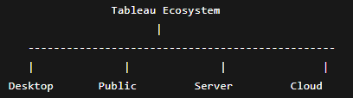

Slide 9
1. Tableau Public
Free version of Tableau for learning and sharing visualizations publicly.
Features
Create dashboards
Publish visualizations online
Free to use
Good for students and portfolio projects
Limitation: ⚠️ Everything you publish is public.
You cannot keep data private.
Best For
Students / Training / Demonstrations / Portfolio building

Slide 10
2. Tableau Desktop
Main development tool used to build dashboards and reports.
Features
Connect to databases
Build visualizations
Create dashboards
Perform calculations
Advanced analytics
Output: Creates files:
.twb
.twbx
Best For
Data analysts / Business analysts / BI developers

Slide 11
3. Tableau Server
On-premises platform for sharing dashboards inside an organization.
Features
Publish dashboards
Manage users
Control permissions
Schedule data refreshes
Installed Where?
Inside the company's own infrastructure.

Slide 12
4. Tableau Cloud
Cloud-hosted version of Tableau Server.
Features
No infrastructure management
Publish dashboards to cloud
User access via browser
Best For
Organizations that prefer SaaS solutions.

